Slide 1
NOI 2012
I am happy with the official contest results
  Can’t reveal anything until this Saturday’s prize giving ceremony ☺
  Solution discussion this Saturday
    More advanced stuffs later in Week12
I can be happier with the guest results
  Next year I have plan to make NOI participation compulsory (either as contestants or as guests) for all
  IOI trainees and probably worth 15% of selection criteria as it is a very controlled contest environment
CS3233 - Competitive Programming,
Steven Halim, SoC, NUS

Slide 2
Class Statistics
(as of Wed 7 March 2012, after mini 6)
Max Claimable Scores so far (total 39.5%):
  6 Mini Contests: 6*3% = 18%
  5 Homework Assignments: 4*2.5%+1.5% = 11.5%
    (HW5 part C and HW 6 are not yet graded)
  1 Mid-Semester Team Contest: 5%
  Up to Achievement 7++: 5%
Highest Scorer so far: 34.4% (87.1% of marks)
Average Scores: 22.1% (55.9% of marks, cut off for B+ is 55%)
Available Scores (60.5%):
  4 More Mini Contests: 4*3% = 12%
  7.5 More Homework Assignments: 1% + 7*2.5% = 18.5%
  1 Final Team Contest: 15%
  The Other Achievements: 15% (can claim more from here, esp UVa apprentice)
CS3233 - Competitive Programming,
Steven Halim, SoC, NUS

Slide 3
What You Have Been Exposed To
(as of Wed 7 March 2012, before lecture of Week08)
Competitive Coding Style, extensive usage of libraries
Bitmask
BIT/FT
Iterative BF Techniques: Subset, Permutation
Recursive backtracking
Some classical Greedy problems
Binary Search the Answer
The thinking process to get DP states and transitions
Graph DS, Traversal: DFS/BFS, MST (briefly), SSSP: Dijkstra’s, Bellman Ford’s, APSP: Floyd Warshall’s
Tarjan’s SCC algorithm
More DP techniques
And we are just HALFWAY ☺
CS3233 - Competitive Programming,
Steven Halim, SoC, NUS

Slide 4
News: iCode 2012
Open to:
  Past and present CS3233 students (only top 10 are eligible)
  Other NUS students (up to 9 contestants), and
  Up to 10 NTU (yes, NTU) students
Qualification round: Online for three weeks
  Week 10/11/12
On site final contest:
  Saturday, 14 April 2012, in PL6
    Three days after CS3233 is over
  Individual contest and has prizes (details TBA)
CS3233 - Competitive Programming,
Steven Halim, SoC, NUS

Slide 5
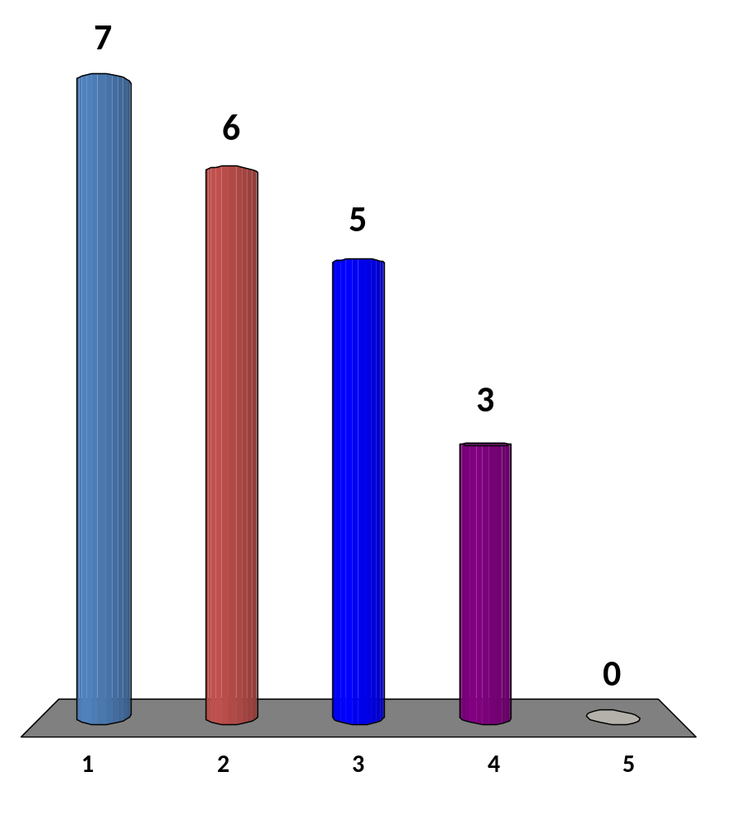
What is your level of understanding of max flow now?
I never heard about it… ☹
I heard about it but I do not know the details
I know the algorithmic details, but have not implemented it yet
I can solve simple max flow/min cut problems ☺
I have solved several advanced variants: MCMF, I can code a faster max flow code than EK’s algorithm that will be shown later, I have solved hard problems that do not look like max flow problem initially
18 of 120
CS3233 - Competitive Programming,
Steven Halim, SoC, NUS
Notes:
Majority is in 1-2-3 (which is “danger” if I give max flow problem).

Slide 6
Let’s View the Visualization
http://www.comp.nus.edu.sg/~stevenha/visualization/maxflow.html
CS3233 - Competitive Programming,
Steven Halim, SoC, NUS

Slide 7
ALTERNATING/AUGMENTING PATH ALGORITHM
Finding MCBM via
CS3233 - Competitive Programming,
Steven Halim, SoC, NUS

Slide 8
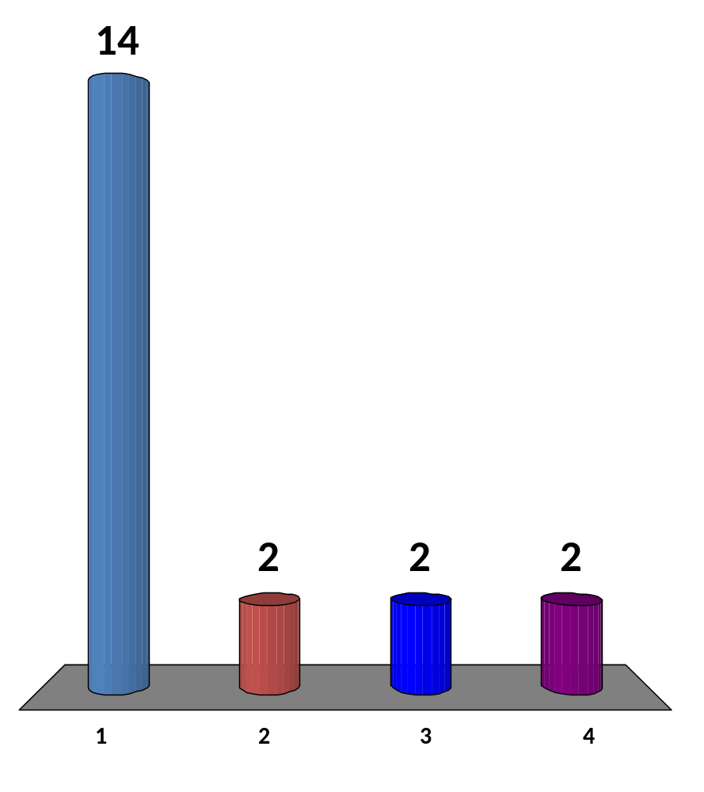
What is your level of understanding of this algorithm?
I have never heard about it before ☹, please tell me
Is this the same algorithm as Hopcroft Karp’s?
I only know the rough idea, never code it…
Yes I know and have coded it several times
19 of 120
CS3233 - Competitive Programming,
Steven Halim, SoC, NUS
Notes:
Majority in 1-2-3, “danger” again

Slide 9
Alternating/Augmenting Path Algorithm
A
B
D
0
1
0
1
0
1
2
3
2
3
2
3
Arbitrary Assignment
1 matching (dotted line)
Augmenting Path 2-3-0-1
After Flip
2 matchings (dotted lines)
C
An augmenting path
F=Free, M=Matched
2
F
3
M
0
F
1
Flip to increase matching
from 1 to 2 matchings
2
M
3
F
0
M
1
Theorem (Berge 1975): A matching M in G is maximum iff there is no augmenting path

Slide 10
The Code ☺
vi owner, visited; // global variables
// return 1 if we find an augmenting path
// return 0 otherwise
int AlternatingPath(int left) {
if (visited[left]) return 0;
visited[left] = 1;
for (int j = 0;
j < (int)AdjList[left].size(); j++) {
int right = AdjList[left][j];
// either greedy assignment
// (if not assigned yet) or recurse
if (owner[right] == -1 ||
AlternatingPath(owner[right])) {
owner[right] = left;
return 1; // found 1 matching
}
return 0; // no matching
}
// in int main()
// build the bipartite graph,
// only directed edge from left
// set to right set is needed
int cardinality = 0;
owner.assign(V, -1);
for (int left = 0;
left < num_vertices_on_left; left++) {
visited.assign(num_vertices_on_left, 0);
cardinality += AlternatingPath(left);
}
printf("Found %d matchings\n", cardinality);
CS3233 - Competitive Programming,
Steven Halim, SoC, NUS

Slide 11
HW7 (due next Wed 11.59am!)
  Go to: http://uhunt.felix-halim.net/id/32900
  Solve UVa 10080 – Gopher II by modeling it as Bipartite Graph and using appropriate solver (either max-flow based or alternating path solution)
  If you have solved these problems in the past, fine, we will count it as “homework part A done”
Solve problem C (Powers) from today
  EMAIL to Harta directly: harta.wijaya.11.10@gmail.com
Write a report on Section 4.6 (Max Flow) + 4.7.4 (Bipartite Graph)
  Upload to IVLE Workbin, “CP2 Review”
    Do something with Chapter 5/6/7/8 to reduce your workload in future weeks
Potential Achievements
  Chapter 4 diversity: Solve eight problems from different category in chapter 4 by the end of Week09 (next week)
  Do something with Chapter 5/6/7/8 diversity to reduce your workload in the next few weeks…

